Slide 1
Pre-Planning Meeting
Region I 2031 Regional Water Plan
September 30, 2026

Slide 2
East Texas Regional Water Planning Group Pre-Planning Meeting
Call to Order
Invocation & Pledge of Allegiance
Notice of Meeting
Roll Call/Determination of Quorum
Public Comments (limited to 5 minutes per speaker)
Adjourn Pre-Planning Meeting

Slide 3
Regional Water Planning Group Meeting
Region I 2031 Regional Water Plan
September 30, 2026

Slide 4
East Texas Regional Water Planning Group Meeting
Call to Order
Confirm Quorum

Slide 5
Item 3
Consideration and approval of the minutes of the February 5, 2026 Meeting

Slide 6
Item 4
Reports from Standing Committees:
  a. Executive Committee – John Martin;
  b. Finance Committee – Teresa Griffin;
  c. Bylaws Committee – David Alders;
  d. Technical Committee – Scott Hall; and,
  e. Nominations Committee – Kelley Holcomb.

Slide 7
Item 5
Consideration, discussion, and possible action to elect Officers and At-Large Executive Committee members in accordance with RWPG Bylaws;

Slide 8
Item 6
Discussion and possible action to appoint new RWPG members;

Slide 9
Item 7
Consideration, discussion, and possible action to accept the recommendation of the City of Nacogdoches’s review committee to select a professional planning and engineering consultant under RFQ No. 26-10-133, and authorize the administrative sponsor to negotiate and execute a professional services contract;

Slide 10
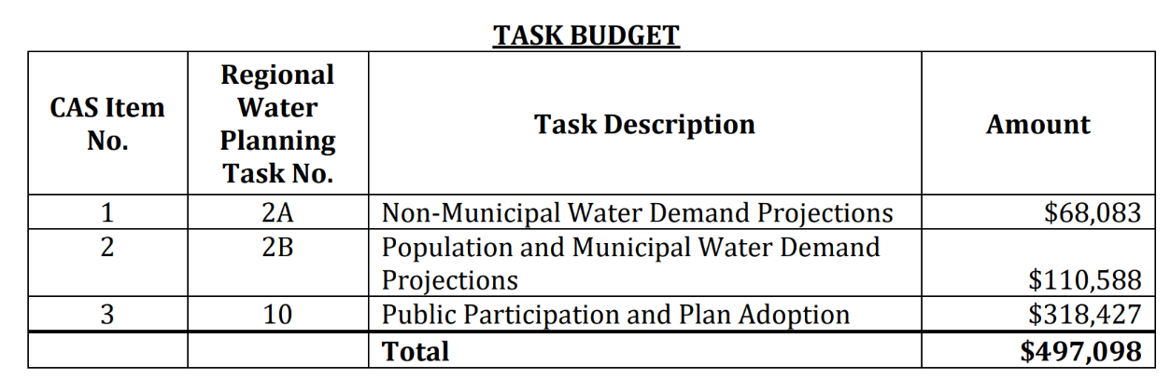
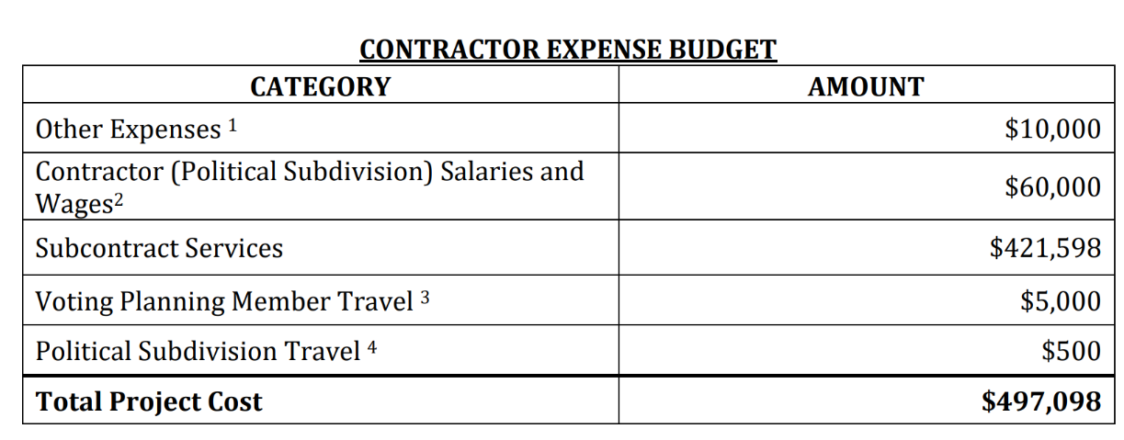
Potential motion to accept the recommendation of the City of Nacogdoches’s review committee to select a professional planning and engineering consultant under RFQ No. 26-10-133 and authorize the administrative sponsor to negotiate and execute a professional services contract.

Slide 11
Item 8
Report from City of Nacogdoches;

Slide 12
Item 9
Reports of Adjoining Regions’ Activity:
  a. Region C – David Montagne;
  b. Region D – Teresa Griffin;
  c. Region H – Scott Hall; and,
  d. Interregional Liaison – Kelley Holcomb

Slide 13
Item 10
Reports from other state agencies, as necessary:
  a. Texas Water Development Board – Lann Bookout;
  b. Texas Department of Parks & Wildlife – Stephen Lange;
  c. Texas Department of Agriculture – Manuel Martinez;
  d. Texas Soil and Water Conservation Board – Trey Watson; and,
  e. Groundwater Management Areas – John Martin/Teresa Griffin

Slide 14
Item 11
General Discussion;

Slide 15
Item 12
Next Meeting Date(s);

Slide 16
Item 13
Adjourn.

Slide 17
Questions
Brigit Buff, PE, PMP, ENV SP
bbuff@plummer.com
972.533.2499

Slide 18
Consultant Presentation for the Pre-Planning Meeting

Slide 19
Agenda
Meeting goals
Overview of Texas Regional Water Planning Process
TWDB Updates and Schedule
Next Steps

Slide 20
Meeting Goals

Slide 21
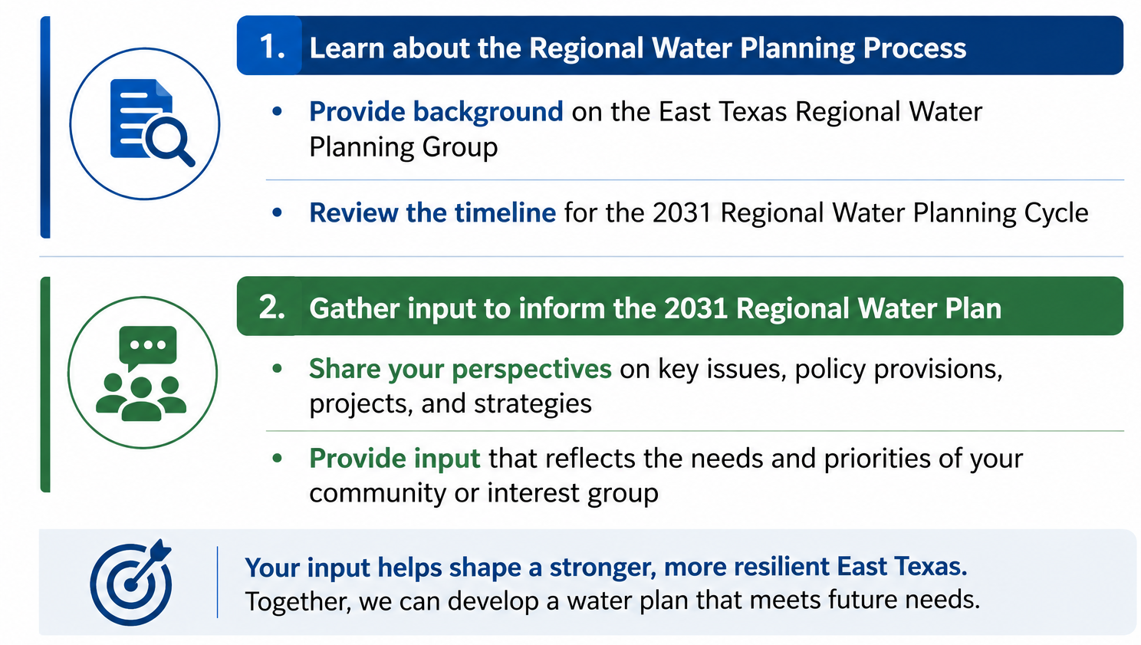
Meeting Goals

Slide 22
Meeting Goals
Learn about the Regional Water Planning Process
Provide background on East Texas Regional Water Planning Group
Review the timeline for 2031 Regional Water Planning Cycle
Identify region priorities for the 2031 RWP
Share your perspectives on key issues, policy provisions, projects, and strategies
Provide input that reflects the needs and priorities of your community or interest group

Slide 23
Overview of Texas Regional Water Planning Process

Slide 24
Texas Regional Water Planning: A Bottom-up Approach
Why it started
Senate Bill 1 (1997)
What makes it “Bottom-Up”
Local stakeholders guide the planning process
Established the regional and statewide water planning process
Developed in response to severe drought conditions in the 1990s
Diverse interests are represented
Planning decisions are developed regionally, not prescribed by the State
Public participation is built into the process

Slide 25
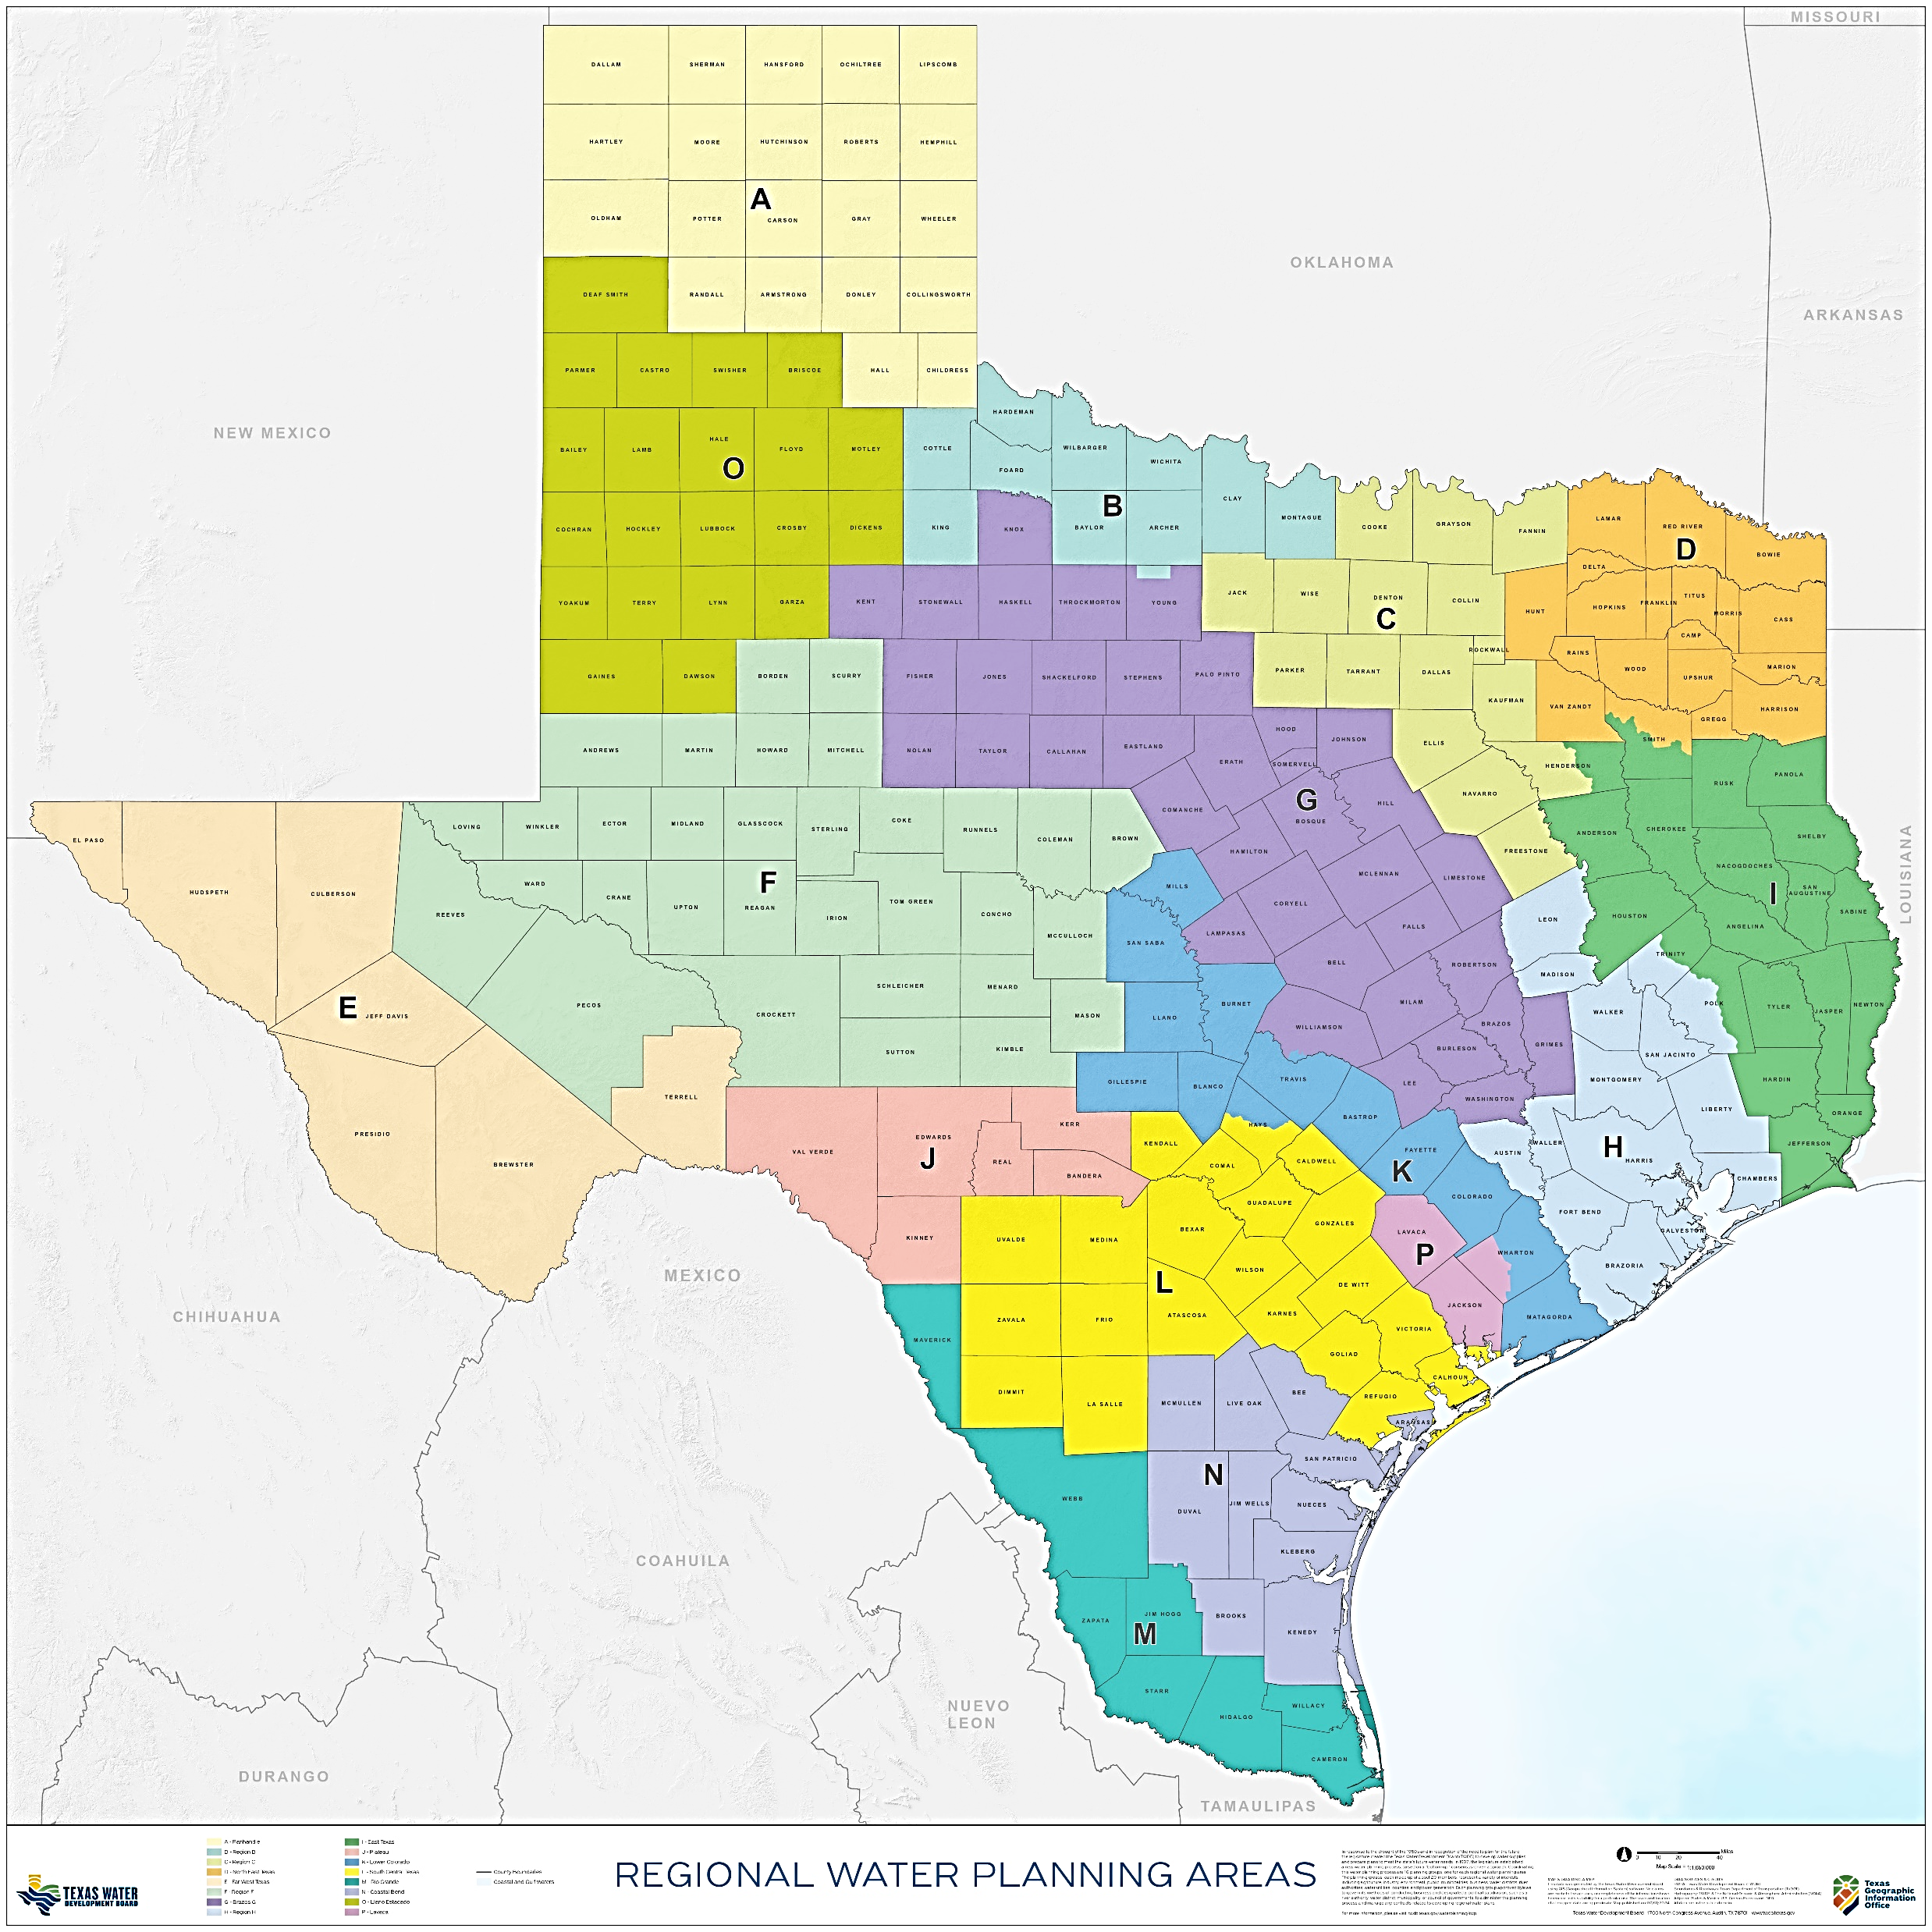
Region I

Slide 26
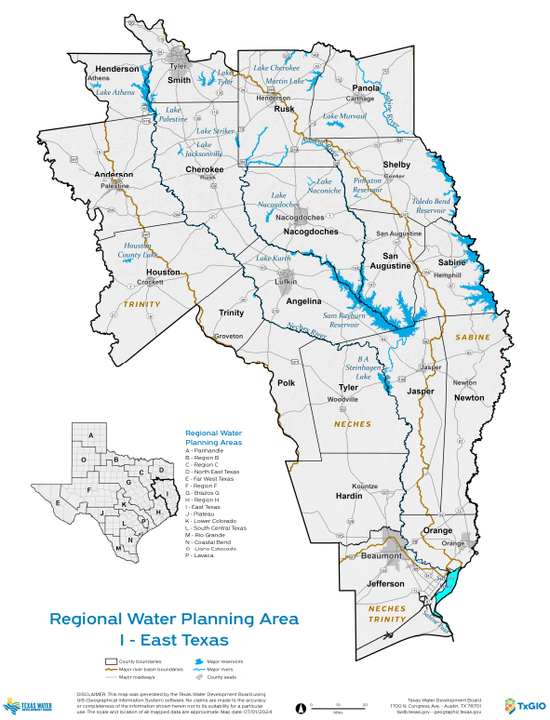
Region I Counties
20 Counties in Region I

Slide 27
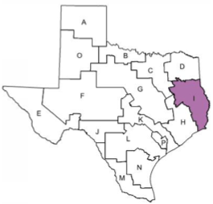
Region I Water Users
285 Primary Region I Water Users
187 Municipal Groups
Other Uses
Manufacturing (18)
Steam Electric (9)
Irrigation (17)
Livestock (19)
Mining (19)
16 Wholesale Providers
Note: Values are based on the 2026 Regional Water Plan and are subjected to change in this planning cycle.

Slide 28
Why is the Regional Water Planning Process Important?
Why is the Regional Water Planning Process Important?
Funding
TWDB (grants & loans) requires “consistency” with State and regional plans
State Water Implementation Fund for Texas require projects be in the Plan
Permits
TCEQ (water rights) requires “consistency” with State and regional plans
Groundwater Conservation Districts – some districts require “consistency”
Consistency
Consistent picture of the overall water supply situation for the State
Education of the Legislature
Dialogue regarding appropriate water supply strategies
Education of the public

Slide 29
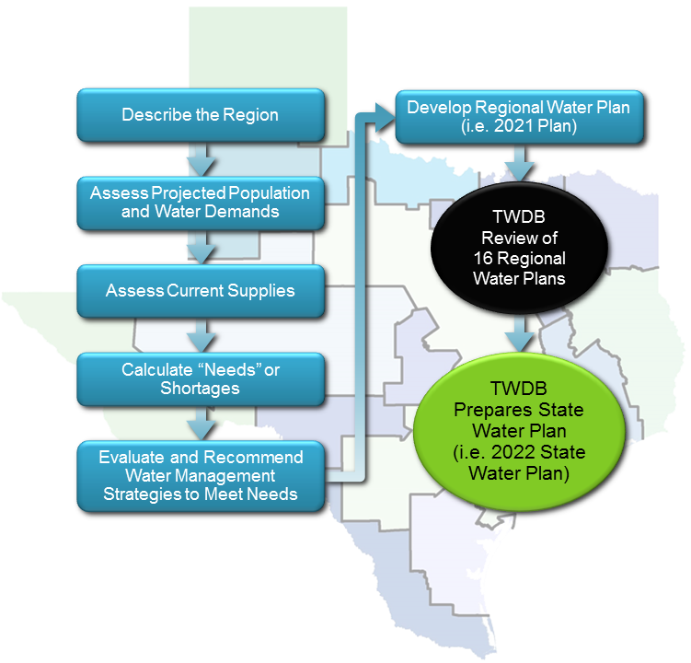
What We Do?
Describe the Region
Develop Regional Water Plan (i.e., 2031Plan)
Assess Projected Population and Water Demands
TWDB Review of 16 Regional Water Plans
Assess Current Supplies
Calculate “Needs” or Shortages
TWDB Prepares State Water Plan (i.e., 2032 State Water Plan)
Evaluate and Recommend Water Management Strategies to Meet Needs
5-Year Cycle, we are in the 7th Cycle

Slide 30
How do we communicate?
Region I website: www.etexwater plan.org
Posted meetings and planning information
Email list of interested parties
Planning group meetings and required public hearings
Surveys of Water User Groups (WUGs), Wholesale Water Providers (MWPs), county judges and groundwater conservation districts
Public presentations when invited and time/funding allows
Virtual/
In-Person meetings to engage and solicit input
Phone calls/emails to & from us (members, administrative agent, consultants)
Email contact widget

Slide 31
TWDB Updates and Schedule

Slide 32
TWDB Staff Updates
William Alfaro, Regional Water Planning Manager, Interim Planner for Region C and E: William.Alfaro@twdb.texas.gov
Elizabeth McCoy, Senior Regional Water Planner: Elizabeth.McCoy@twdb.texas.gov
Lann Bookout, Planner for Regions I, J, K, and H (Interim): Lann.Bookout@twdb.texas.gov
Michele Foss, Planner for Regions D, L, N, and P (Interim): Michele.Foss@twdb.texas.gov
Brittany Condry, Planner for Regions B, G, O: Brittany.Condry@twdb.texas.gov
Noah Powell, Planner for Regions A, F, M: Noah.Powell@twdb.texas.gov

Slide 33
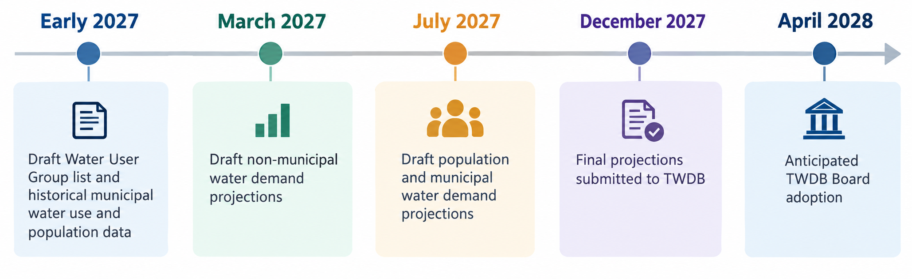
Population and Demand Projection Schedule

Slide 34
Population and Demand Projection Schedule
Early 2027: Draft WUG list and historical municipal water use/population data
March 2027: Draft non-municipal demand projections
July 2027: Draft population and municipal demand projections
December 2027: Final projections submitted
April 2028: Anticipated TWDB Board adoption

Slide 35
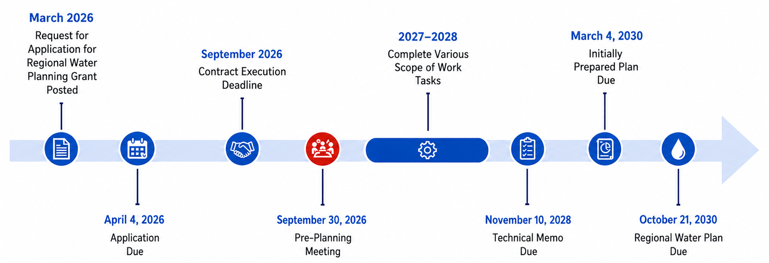
RWP Schedule

Slide 36
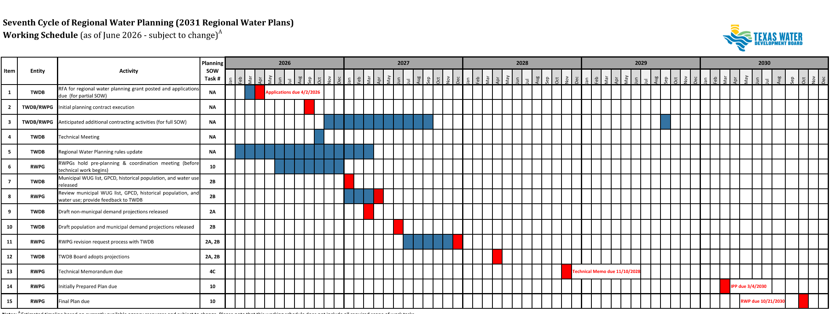
Detailed Schedule
We are here

Slide 37
Next Steps

Slide 38
Next Steps
Finalize contract with Consultant team
Receive TWDB planning information in Spring 2027 and begin the 2031 Regional Water Planning effort.

